Slide 1
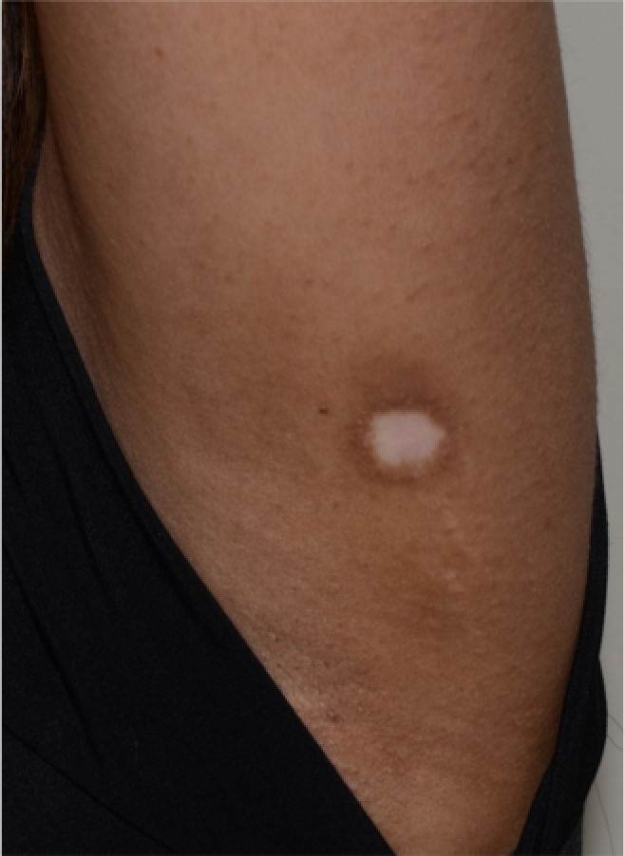
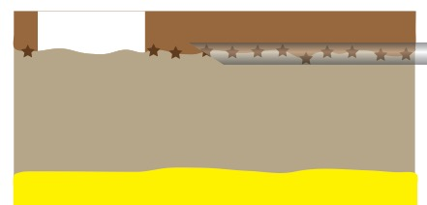

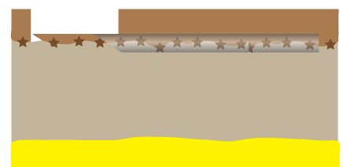
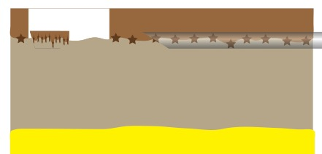
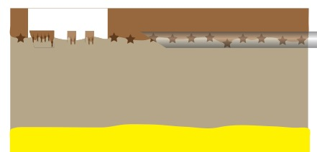
Proposed Mechanism of Repigmentation following Needling in Vitiligo
Noufal Raboobee, Westville Hospital, Durban, South Africa
INTRODUCTION
Needling is a technique where a needle is introduced from normal to vitiligo skin in order to achieve repigmentation(1).
Ahmad et al, in their original article (1) proposed that repigmentation of white patches occurs mainly from melanocytes which are physically dragged or pushed by the tip of the needle from the coloured margins of the patch.
The author wishes to propose a possible alternate mechanism of repigmentation due to needling viz. that the needle cuts a core of tissue when introduced into the skin, much like a biopsy punch. Since needling is performed horizontally, at the dermo-epidermal junction, the core is rich in melanocytes. This core is trapped in the lumen of the needle and is carried into the vitiligo area by the advancing needle. When the needle is withdrawn, friction between the surrounding vitiligo skin and the exposed tip of the core in the needle causes the core to detach from the needle and remain behind in the vitiligo skin. The degree of intactness of the core will determine the pattern of repigmentation as described below.
PATTERNS OF REPIGMENTATION FOLLOWING NEEDLING
During the course of needling, the following repigmentation patterns were observed:
Linear streaks of pigment along needled path.
Hyperpigmentation at edge of the vitiligo lesion.
Pigment away from the edge, corresponding to the most distant point that the tip of the needle reaches.
Isolated dots of pigment along the length of the path taken by the needle. These dots may or may not be in contact with the pigmented border.
DISCUSSION
Needling is an inexpensive technique that offers an adjunctive therapeutic modality for the treatment of vitiligo.
The technique may be used alone, or combined with narrow band UVB or Excimer Laser/Light.
A 30G insulin needle is inserted about 1 cm from the edge of a vitiligo lesion and advanced repeatedly along the margin towards the centre of the depigmented patch. Local anaesthetic reduces the discomfort associated with the procedure.
Observation of repigmentation patterns following needling give some insight into the mechanism of repigmentation suggesting that a core of melanocyte rich tissue is transplanted from the pigmented skin onto the vitiligo area.
Innovative methods will be required to test this hypothesis. Further studies are required to determine whether i) a larger gauge needle will increase the amount of repigmentation, ii) drawing air or water into the syringe and pushing the plunger during needling will help dislodge the melanocyte-containing core, iii) needling in multiple directions will increase repigmentation.
CONCLUSION
Rather than melanocytes being pushed by the tip of the needle, it is more plausible to consider that needling transplants a core of melanocyte-containing tissue from normally pigmented to vitiligo skin.
Email for correspondence: raboobee@iafrica.com

⬆



1
2
3
4
PROPOSED MECHANISM OF DEVELOPMENT OF ABOVE CLINICAL PATTERNS
a) A core of skin is cut by the advancing needle, much like a punch biopsy, except in horizontal orientation.
b) As the needle advances, it carries this core of melanocyte-rich epidermis within its lumen.
c) As the needle is withdrawn, friction between the tip of the core and the surrounding skin causes the core to remain behind in the vitiligo skin. If the entire core is left behind uninterrupted, linear streaks of re-pigmentation will be seen. Hyperpigmentation at the edges develops when the core overlaps normal skin.
d) If the entire core is deposited at the end of the needle, pigment will only be seen away from the edge, at the site corresponding to the tip of the needle at its maximally advanced point.
e) Should the core break up and become deposited along the path of the withdrawing needle, pigment foci will be visible as separate dots along the path of the needle. If the core does not dislodge from the needle, no repigmentation will occur.
1. Ahmad TJ, Rashid T, Rani Z. Needling: an adjunct to narrowband ultraviolet B therapy in localized fixed vitiligo. J Pakistan Assoc of Dermatologists 2008; 18: 149-153

